Slide 1
Fake News
Do Now: How would you define “fake news”?
Why is “fake news” so common?

Slide 2
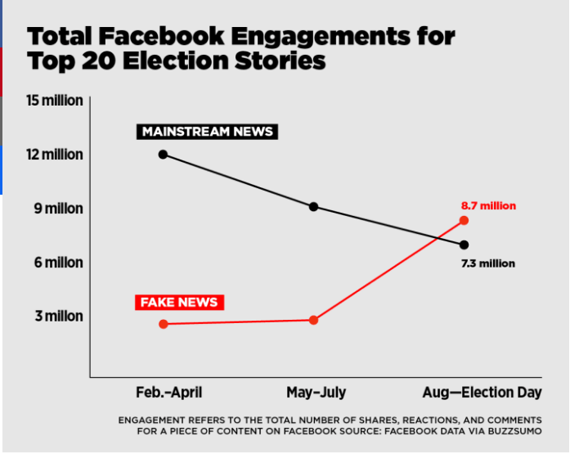

Slide 3
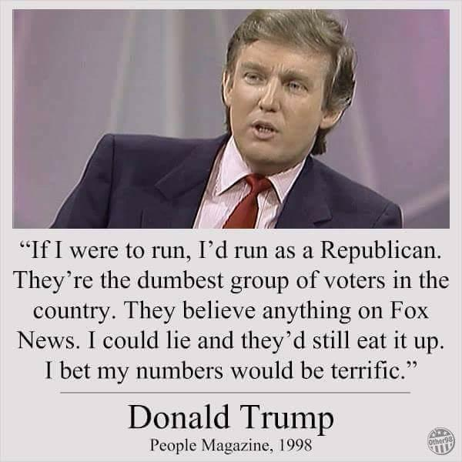

Slide 4
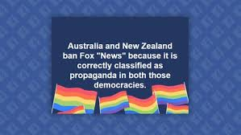

Slide 5
