Slide 1
Theory of Knowledge (TOK) in the subjects
BLOG POST

Slide 2
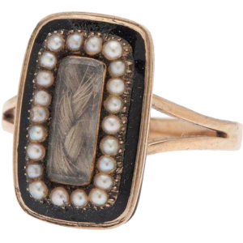
More

Slide 3
Now that we’ve tried to figure out what some objects are... let’s consider how much they’re worth.
How valuable are the following objects?

Slide 4
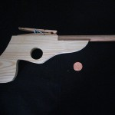
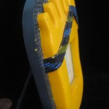
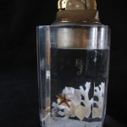
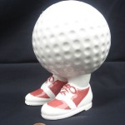
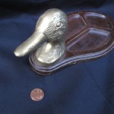
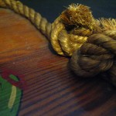
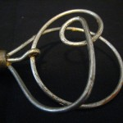

Slide 5
What if I told you they belonged to someone famous?
That there was a special story behind each one?

Slide 7
The Significant Objects Project
Created by Rob Walker and Joshua Glenn, the project was created to see how much narrative and viewer perception could change our notions of value
Walker & Glenn collected thrift-store objects purchased for $1.25 each on average
The objects were auctioned on eBay with backstories provided by assorted authors
The eBay listings clearly stated that each backstory was a work of fiction. A link was provided to significantobjects.com

Slide 8
The Project made nearly $8000 off of nearly-worthless junk.
Why? What Ways of Knowing were used to create this change in value?

Slide 9
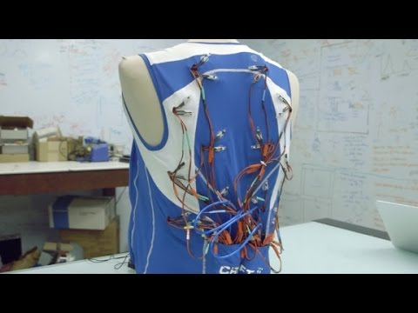

Slide 10
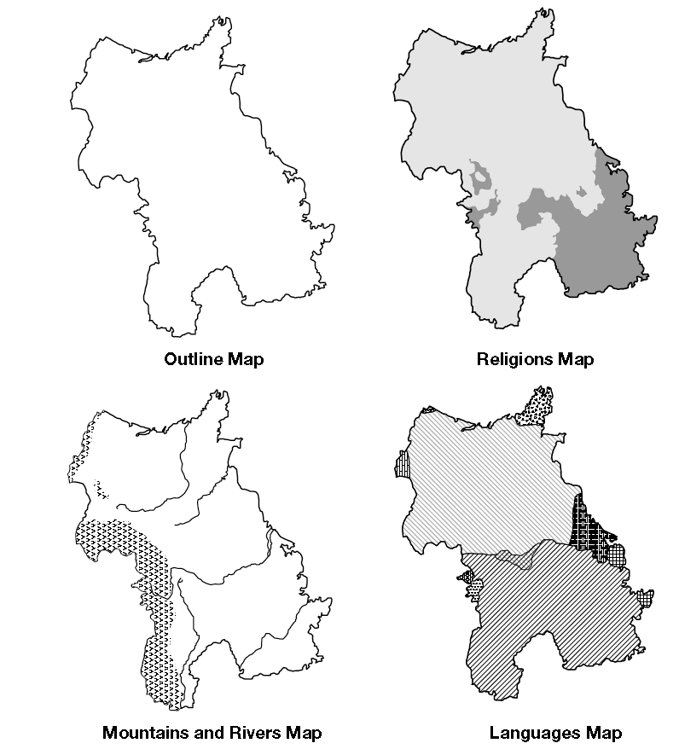

MAP
ACTIVITY...

Slide 11
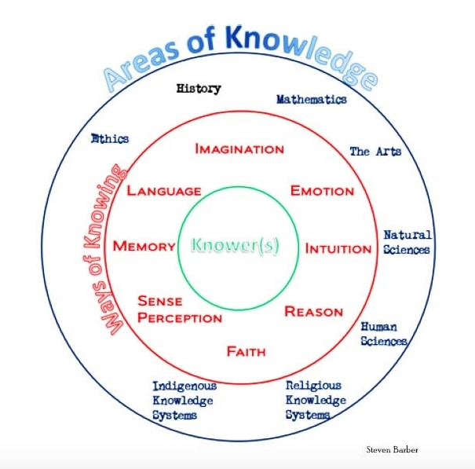
Think of ToK as a
TOOLBOX for CRITICAL THINKING

Slide 12
WHAT IF? - Imagine a world in which...
women occupy every position of authority
art is illegal
50% of the population can read minds
there is no written language
animals can talk to humans
long term memory does not exist
God lives among us
every citizen owns a handgun
everyone is blind
couples do not procreate; they shop for their offspring
every individual has two selves but one consciousness
there is no such thing as shame, embarrassment, regret, or guilt
all human interaction (socializing, shopping, working, dating, etc.) is done through the Internet
every individual is owned by a corporation
racial equality has been achieved
all humans know the exact date and time of their own death
there is only one religion on the planet
all aspects of human interaction are available to the public (cameras everywhere, no privacy on social media, etc.)
Choose ONE of the following IMAGINE situations. What would this world look like? How would it change our daily lives, our concept of knowledge, our ways of knowing, etc.? What are the ramifications/implications of this?

Slide 13
Jump to:
TOK and the IB Learner Profile
Language & Literature
Language Acquisition
Individuals & Society
Sciences
Math(s)
Art
Physical Education
Design
General
Links

Slide 14

TOK and the IB Learner Profile
From the Theory of Knowledge Guide

Slide 15
The IB Learner Profile and TOK
Attribute | Link to TOK
Inquirers | TOK students seek to find out how knowledge is constructed using various ways of knowing and by considering what constitutes knowledge in various areas of knowledge. It is a fundamental premise of TOK that personal knowledge should not result from simple acceptance of knowledge claims without sufficient inquiry and evidence.
Knowledgeable | TOK students strive to be knowledgeable about the nature of knowledge. This means becoming knowledgeable about the methods of inquiry of a variety of subject areas, from a number of perspectives. Students are encouraged to explore the processes by which individuals arrive at their own knowledge and understanding of the world and the presuppositions that underpin this understanding.
Thinkers | TOK students examine thinking in order to understand what constitutes good thinking and also to recognize potential flaws in thought processes. Students also think about what thinking is required in a variety of situations, as well as how thinking relates to emotional processing and intuition.

Slide 16
The IB Learner Profile and TOK
Attribute | Link to TOK
Communicators | TOK students are required by the TOK assessment tasks to communicate their understanding and perspective in both oral and written form. Students also study the language that is used to develop a body of knowledge, so they learn what gives language its power as well as what causes failures of communication.
Principled | TOK students scrutinize knowledge in a critical manner, leading to what could be called principled knowledge. Students are required to examine the relationship between possessing knowledge and the moral obligations that this carries. Learning to see the world from a TOK perspective challenges students to think about acting in principled ways.
Open-Minded | TOK students need to be open-minded about knowledge claims they encounter. They will learn not to simply accept claims at face value, but to consider the factual accuracy of any proposition and the potential emotional, social or cognitive bias of any person making a proposition. At the same time, they must learn to balance skepticism with belief, and recognize that in many situations there is a need to make decisions without possessing absolute certainty.

Slide 17
The IB Learner Profile and TOK
Attribute | Link to TOK
Caring | TOK students are asked to care about how they use their knowledge. This necessarily means thinking about how knowledge can be used in sympathetic, empathetic and compassionate ways.
Risk-Takers | TOK students must be willing to risk questioning what they hold to be true. This means that they must be willing to risk being wrong. When we are willing to accept being wrong then we make progress towards correcting existing misconceptions and increasing our knowledge and understanding of the world. The word “judgment” is central in TOK, and students should be prepared to take the risks involved in making judgments in matters where the evidence does not definitively favour one view or another, while at the same time acknowledging the provisional nature of these judgments.

Slide 18
The IB Learner Profile and TOK
Attribute | Link to TOK
Balanced | TOK students are committed to viewing knowledge claims from different perspectives. They are also required to consider a range of areas of knowledge. TOK requires a balance of ability in speaking and writing, and a balance of ability in drawing general conclusions from specific examples and in drawing on specific examples to demonstrate general claims.
Reflective | TOK students learn to reflect on the degree to which their own and other people’s motivations, beliefs, thought processes and emotional reactions influence what they know and what they are capable of knowing.

Slide 19
Language & Literature
Group One

Slide 20
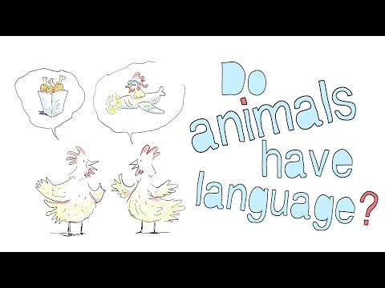
Do Animals Have Language?
“All animals communicate. But do they have language? Michele Bishop details the four specific qualities we associate with language and investigates whether or not certain animals utilize some or all of those qualities to communicate.”

Slide 21


Animals and Language
BBC: Is language unique to humans?
TED ED: Do Animals have language?
What does a parrot know about PTSD?

Slide 22
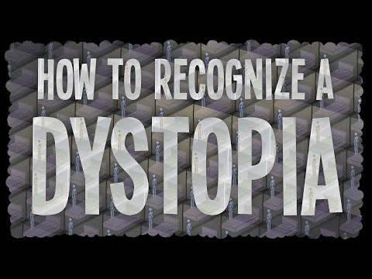
How to Recognize Dystopia!
“The genre of dystopia – the ‘not good place’– has captured the imaginations of artists and audiences alike for centuries. But why do we bother with all this pessimism? Alex Gendler explains how dystopias act as cautionary tales – not about some particular government or technology, but the very idea that humanity can be molded into an ideal shape.”

Slide 23
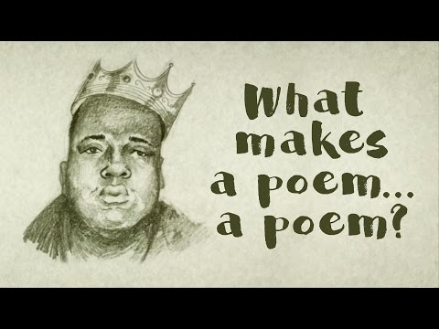
What makes a poem a poem?
“What exactly makes a poem … a poem? Poets themselves have struggled with this question, often using metaphors to approximate a definition. Is a poem a little machine? A firework? An echo? A dream?”

Slide 24
How does language shape knowledge?
Link - Language

Slide 25
Does the importance of language in an area of knowledge ground it in a particular culture?
Link - Language

Slide 26
How are metaphors used in the construction of knowledge?
Link - Language

Slide 27
What is the role of language in sense perception?
Link - Sense Perception

Slide 28
What is the role of imagination in producing knowledge about a real world?
Link - Imagination

Slide 29
Can imagination reveal truths that reality hides?
Link - Imagination

Slide 30
What is the role of the imagination in understanding others?
Link - Imagination

Slide 31
What role does language play in the accumulation of knowledge?
Link

Slide 32
For Political Cartoons:
Does the language employed in the cartoon convey the facts of the situation accurately?
What emotional response(s) is (are) the cartoon likely to trigger in viewers?
How are the means by which this, or any, political cartoon endeavours to convince people of a particular viewpoint different from the means by which other media strive to do the same thing?
How is the use of an image to convey an idea different from the use of words to convey an idea?
What reading, thinking and viewing skills does an audience require in order to be able to assess this (or any) political cartoon in a balanced way?
To what extent does a political cartoonist count on his audience reacting out of intuition rather than reason?
Should political cartoons be considered art? They employ some of the methodologies of art, but do they fit into the scope of the arts?
Link

Slide 33
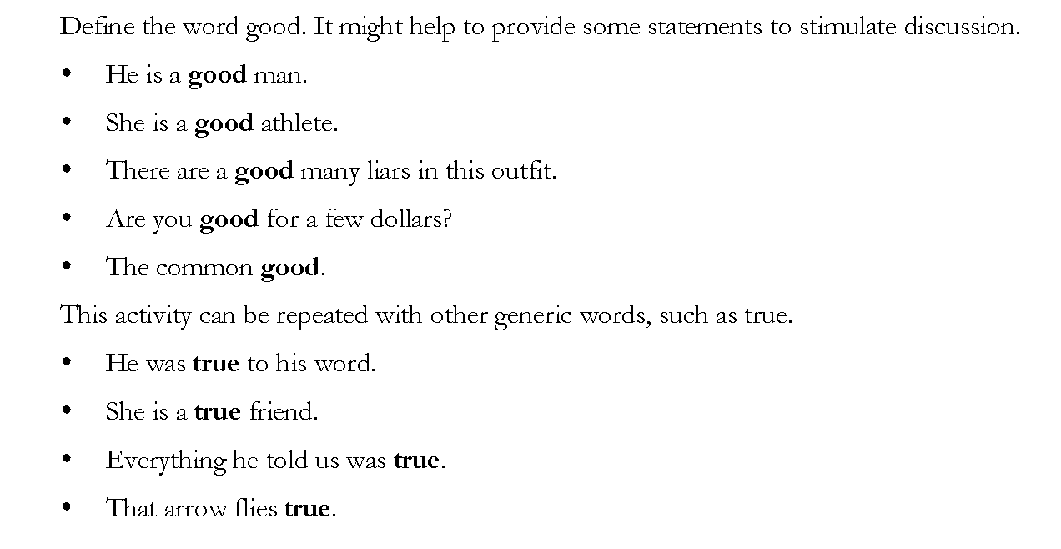
Teacher Support Material—Theory of Knowledge Lessons from Around the World - © IBO, August 2000 Lesson 4—page 1

Slide 34
Is knowing how to use a word similar to knowing how to walk or swim; that is, could it be viewed as a skill?
Teacher Support Material—Theory of Knowledge Lessons from Around the World - © IBO, August 2000 Lesson 4—page 2

Slide 35
Do words have meanings or do we give them meanings?
Teacher Support Material—Theory of Knowledge Lessons from Around the World - © IBO, August 2000 Lesson 4—page 2

Slide 36
Language Acquisition
Group Two

Slide 37
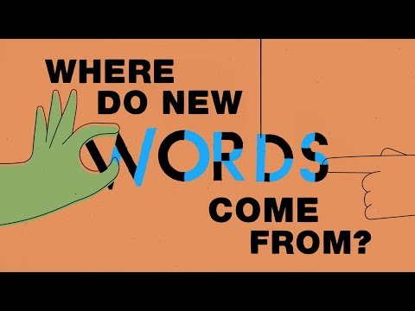
Where do new words come from?
“There are over 170,000 words currently in use in the English language. Yet every year, about a thousand new words are added to the Oxford English Dictionary. Where do they come from, and how do they make it into our everyday lives? Marcel Danesi explains how new words enter a language.”
Link

Slide 38
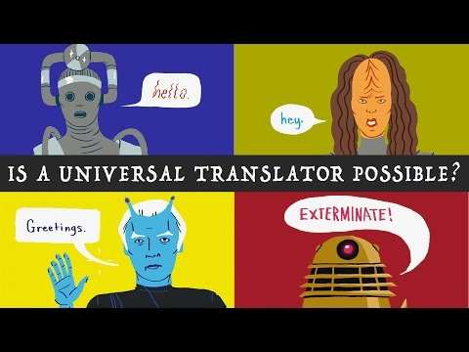
Can Computers Understand Language?
“Is a universal translator possible in real life? We already have many programs that claim to be able to take a word, sentence, or entire book in one language and translate it into almost any other. The reality, however, is a bit more complicated. “
Link

Slide 39
What role does language play in the accumulation of knowledge?
Link

Slide 40
Do people who speak in different languages think differently?

Slide 41
Are some languages more emotional than other languages?

Slide 42
Teacher Support Material—Theory of Knowledge Lessons from Around the World - © IBO, August 2000 Lesson 4—page 1

Slide 43
Is knowing how to use a word similar to knowing how to walk or swim; that is, could it be viewed as a skill?
Teacher Support Material—Theory of Knowledge Lessons from Around the World - © IBO, August 2000 Lesson 4—page 2

Slide 44
Do words have meanings or do we give them meanings?
Teacher Support Material—Theory of Knowledge Lessons from Around the World - © IBO, August 2000 Lesson 4—page 2

Slide 45
Individuals & Society
Group Three

Slide 46
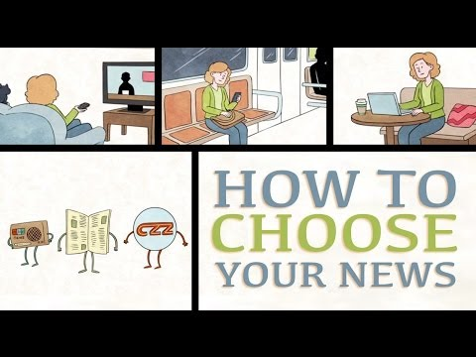
If news is fact based, why do we choose different places to get our news?
“With the advent of the Internet and social media, news is distributed at an incredible rate by an unprecedented number of different media outlets. How do we choose which news to consume?”
Link

Slide 47
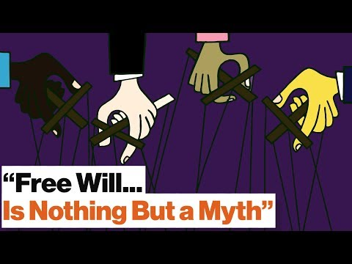
Do we have free will?
Robert Sapolsky posits that "I picked this shirt today because the culture I come from has these values and my visual color receptors told me that this shirt matches with this." It might be far fetched to some, but consider this: if the street you'd grown up on was wide (say, a Texas highway) and at age 30 you moved to a tiny cobblestone street, you'd feel cramped in. Apply this to everything around you and you'll get a sense of what Sapolsky is talking about.

Slide 48
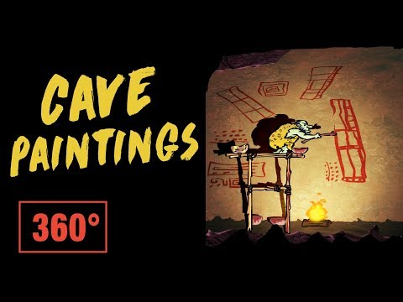
How much can we know about our ancestors from the clues they leave behind?
“The paintings of our ancestors have been preserved in caves all over the world; the oldest we’ve found were made up to 40,000 years ago. What do these images tell us about the ancient human mind and the lives of their creators?”

Slide 49
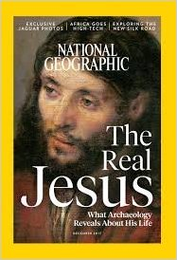
The Real Jesus
“What Archaeology Is Telling Us About the Real Jesus”
+Click to explore portrayals of Jesus

Slide 50

Texas Textbooks
Texas Textbook Called Out As 'Racist' Against Mexican-Americans
Do new Texas textbooks whitewash slavery and segregation?

Slide 51
Are Emotions Always Linked to Belief?
Link - Emotions

Slide 52
Can we know things which are beyond our personal present experience?
Link - Memory

Slide 53
Is eyewitness testimony a reliable source of evidence?
Link - Memory

Slide 54
Can our beliefs contaminate our memory?
Link - Memory

Slide 55
What is unique about the methodology of history?
Link

Slide 56
How do we decide which events are historically significant?
Link
A History of the World in 100 Objects

Slide 57
Is it possible for historical writing to be free from perspective?
Link - Figure 14

Slide 58
How does a historian assess the reliability of sources?
Link - Figure 14

Slide 59
How can one gauge the extent to which a history is told from a particular cultural or national perspective?
Link - Figure 14

Slide 60
What is a fact in history?
Link - Figure 14

Slide 61
How can historical accounts be assessed?
Link - Figure 14

Slide 62
What is the relation between the style of language used and the history written?
Link - Figure 14

Slide 63
How have we recorded information through time?
History of Information

Slide 64
Is history created?

Slide 65
Is there such a thing as moral knowledge?
Link

Slide 66
Does the rightness or wrongness of an action depend on the situation?
Link

Slide 67
Are all moral opinions equally valid?
Link

Slide 68
Is there such a thing as a moral fact?
Link

Slide 69
How are conflicts between different ethical systems resolved?
Link - Figure 16

Slide 70
To what extent might lack of knowledge be an excuse for unethical conduct?
Link - Figure 16

Slide 71
To what extent might possession of knowledge carry with it moral obligations?
Link - Figure 16

Slide 72
For Political Cartoons:
Does the language employed in the cartoon convey the facts of the situation accurately?
What emotional response(s) is (are) the cartoon likely to trigger in viewers?
How are the means by which this, or any, political cartoon endeavours to convince people of a particular viewpoint different from the means by which other media strive to do the same thing?
How is the use of an image to convey an idea different from the use of words to convey an idea?
What reading, thinking and viewing skills does an audience require in order to be able to assess this (or any) political cartoon in a balanced way?
To what extent does a political cartoonist count on his audience reacting out of intuition rather than reason?
Should political cartoons be considered art? They employ some of the methodologies of art, but do they fit into the scope of the arts?
Link

Slide 73
Sciences
Group Four

Slide 74
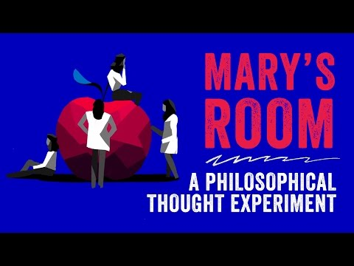
Imagine a neuroscientist who has only ever seen black and white things, but she is an expert in color vision and knows everything about its physics and biology. If, one day, she sees color, does she learn anything new?
Link

Slide 75
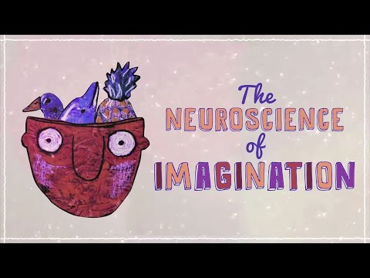
How does your brain produce an image of something you’ve never seen?
“Imagine, for a second, a duck teaching a French class. A ping-pong match in orbit around a black hole. A dolphin balancing a pineapple. You probably haven’t actually seen any of these things. But you could imagine them instantly. How does your brain produce an image of something you’ve never seen?”
Link

Slide 76
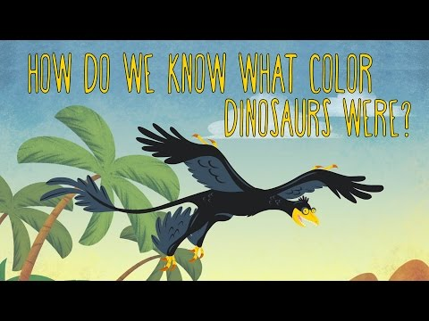
Why do we think all dinosaurs are green?
“The microraptor was a four-winged carnivorous dinosaur with iridescent black feathers. But if our information about this dinosaur comes from fossils, how can we be certain about its color?”
Link

Slide 77
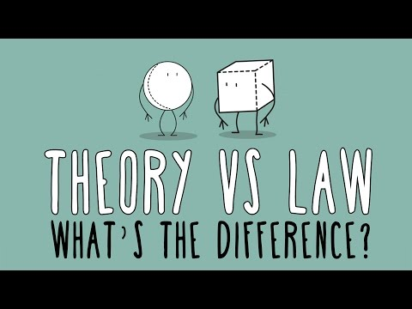
What is the difference between scientific law and scientific theory?
“Chat with a friend about an established scientific theory, and she might reply, “Well, that’s just a theory.” But a conversation about an established scientific law rarely ends with “Well, that’s just a law.” Why is that? What is the difference between a theory and a law... and is one “better”?”
Link

Slide 78
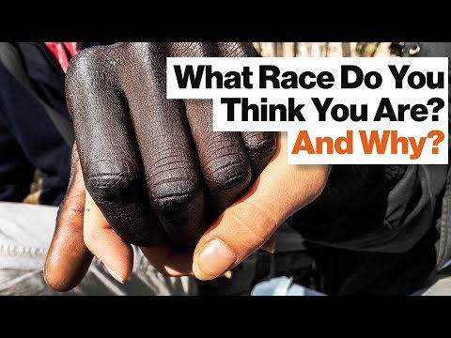
Is Race Genetic or Socially Constructed?
“How many different races are there? Pick a number, any number, says philosophy professor Philip Kitcher.”
Link

Slide 79
What is the Difference Between Belief and Logic?
Link - Reason

Slide 80
How reliable is inductive reasoning?
Link - Reason

Slide 81
Are we predictably irrational?
Link - Reason

Slide 82
Does faith meet a psychological need??
Link - Faith

Slide 83
Do you need scientific proof to believe something?

Slide 84
Should there be ethical constraints on the pursuit of scientific knowledge?
Link

Slide 85
Is there just one scientific method?
Link

Slide 86
How does one know in advance which factors (to measure, say) will be relevant to the final explanation?
Link - Figure 12

Slide 87
How can one decide when one model/ explanation/ theory is better than another?
Link - Figure 12

Slide 88
How can it be that scientific knowledge changes over time?
Link - Figure 12

Slide 89
Can human behaviour be subject to laws in the same way as the material world?
Link

Slide 90
What constitutes good evidence in the human sciences?
Link

Slide 91
To what extent might lack of knowledge be an excuse for unethical conduct?
Link - Figure 16

Slide 92
To what extent might possession of knowledge carry with it moral obligations?
Link - Figure 16

Slide 93
Is Time Real?

Slide 94
Math(s)
Group Five

Slide 95
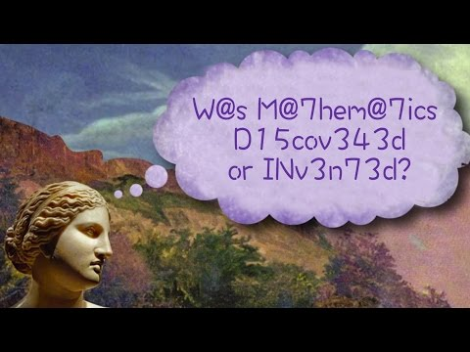
Is Math(s) Discovered or Invented?
“Would mathematics exist if people didn't? Did we create mathematical concepts to help us understand the world around us, or is math the native language of the universe itself? Jeff Dekofsky traces some famous arguments in this ancient and hotly debated question.”
Link

Slide 96
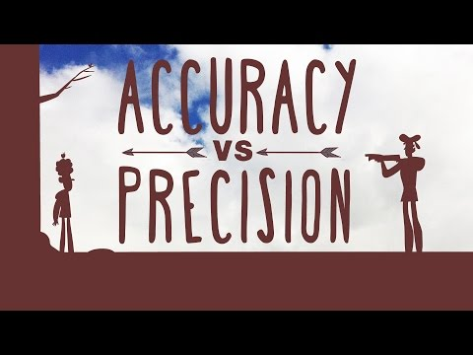
In math(s) can we ever be precise?
“When we measure things, most people are only worried about how accurate, or how close to the actual value, they are. Looking at the process of measurement more carefully, you will see that there is another important consideration: precision”
Link

Slide 97
What is Math(s)?
From a TOK sample unit

Slide 98
Does Zero Exist?

Slide 99
What is the connection between mathematics and logic?

Slide 100
Is there a distinction between truth and certainty in mathematics?
Link

Slide 101
Is mathematics independent of culture?
Link

Slide 102
What is the Difference Between Belief and Logic?
Link - Reason

Slide 103
Are we predictably irrational?
Link - Reason

Slide 104
If mathematics is an abstract intellectual game (like chess) then why is it so good at describing the world?
Link - Figure 11

Slide 105
Why is there sometimes an uneasy fit between mathematical descriptions and the world? (For example, if I had four cows and then took five away, how many would be left?)
Link - Figure 11

Slide 106
If mathematics is created by man, why do we sometimes feel that mathematical truths are objectives facts about the world rather than something constructed by human beings?
Link - Figure 11

Slide 107
If mathematics is 'out there' in the world then where exactly can it be found?
Link - Figure 11

Slide 108
Why should elegance or beauty be relevant to mathematical value?
Link - Figure 11

Slide 109
Arts
Group Six

Slide 110
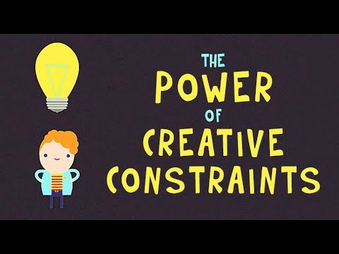
Can constraints make us more creative?
“Imagine you were asked to invent something new. It could be whatever you want, made from anything you choose, in any shape or size. That kind of creative freedom sounds so liberating, doesn’t it? Or ... does it? if you're like most people you’d probably be paralyzed by this task. Why?”

Slide 111
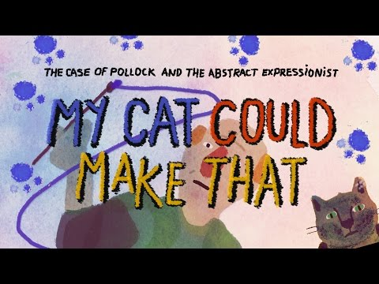
What counts as ‘art’?
“If you visit a museum with a collection of modern and contemporary art, you’re likely to see works that sometimes elicit the response, “My cat could make that, so how is it art?” But is it true? Could anyone create one of Jackson Pollock’s drip paintings?”

Slide 112
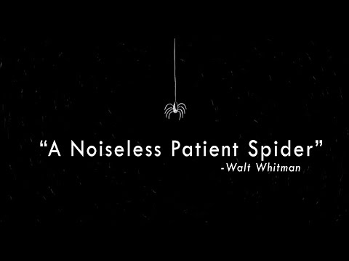
Do we imagine the same way?
“A poetic experiment: Walt Whitman, interpreted by three animators”
Link

Slide 113
Do we all see color the same way?

Slide 114
Why do we like what we like?

Slide 115
If over hundreds of years a piece of art has parts replaced, till there is nothing left - is it still as important? Is it still the original? Do we value it the same?

Slide 116
Why do we have different tastes?

Slide 117
How can we know if our senses are reliable?
Link - Sense Perception

Slide 118
Are Emotions Universal?
Link - Emotions

Slide 119
What is the role of imagination in producing knowledge about a real world?
Link - Imagination

Slide 120
Can imagination reveal truths that reality hides??
Link - Imagination

Slide 121
What is the role of the imagination in understanding others?
Link - Imagination

Slide 122
How can the subjective viewpoint of an individual contribute to knowledge in the arts?
Link

Slide 123
On what basis can the merit of a work of art be judged?
Link

Slide 124
Is there any point in discussing the arts—should we not simply experience them?
Link

Slide 125
Who decides what is classified as Art?

Slide 126
If someone creates an exact copy of the original piece of artwork, should it be valued the same way?

Slide 127
Is any art unique?

Slide 128
What is the relationship between the artist and the artwork?
Link - Figure 15

Slide 129
Is the aesthetic value or an artwork purely a subjective matter?
Link - Figure 15

Slide 130
What is the importance of form in an artwork?
Link - Figure 15

Slide 131
Is it possible that aesthetic value is at its base something universal - a fact about human beings?
Link - Figure 15

Slide 132
Physical Education
Group Seven

Slide 133
Why are some people considered more intuitive than others?
Link - Intuition

Slide 134
Are there certain things that you have to know prior to being able to learn anything at all?
Link - Intuition

Slide 135
Should you trust your intuition?
Link - Intuition

Slide 136
Design
Group Eight

Slide 137
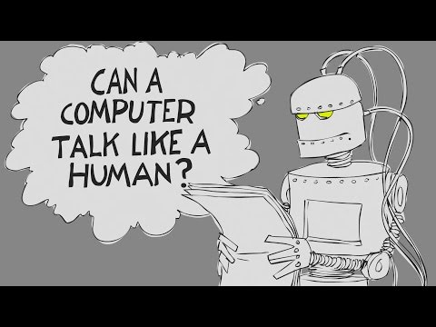
What is consciousness? Can an artificial machine really think?
“For many, these have been vital considerations for the future of artificial intelligence. But British computer scientist Alan Turing decided to disregard all these questions in favor of a much simpler one: Can a computer talk like a human? Alex Gendler describes the Turing test and details some of its surprising results.”
Link

Slide 138
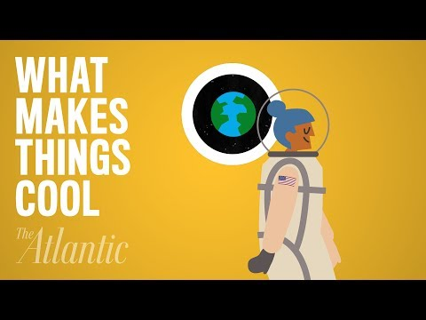
What Makes Things Cool?
“A 20th century industrial designer, who created some of America’s most iconic looks, developed a theory of coolness that has been backed up by various scientific studies. The Atlantic explains the science behind why we like what we like.”
Link

Slide 139
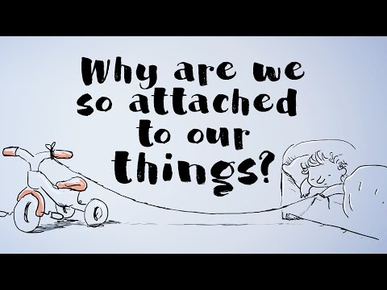
Why are we so attached to our things?
“After witnessing the “violent rage” shown by babies whenever deprived of an item they considered their own, Jean Piaget – a founding father of child psychology – observed something profound about human nature: Our sense of ownership emerges incredibly early. But why do we become so attached to things?”
Link

Slide 140
Can Computers Understand Language?
“Is a universal translator possible in real life? We already have many programs that claim to be able to take a word, sentence, or entire book in one language and translate it into almost any other. The reality, however, is a bit more complicated. “
Link

Slide 141
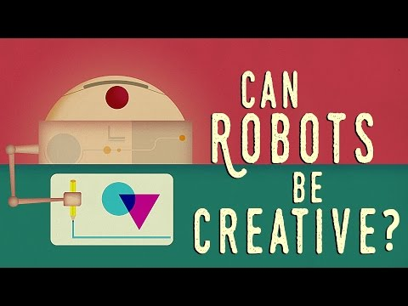
Can Robots be Creative?
“People have been grappling with the question of artificial creativity -- alongside the question of artificial intelligence -- for over 170 years. For instance, could we program machines to create high quality original music? And if we do, is it the machine or the programmer that exhibits creativity? Gil Weinberg investigates this creative conundrum.“
Link

Slide 142
Why should elegance or beauty be relevant to mathematical value?
Link - Figure 11

Slide 143
What is the role of imagination in producing knowledge about a real world?
Link - Imagination

Slide 144
What is the importance of form in an artwork?*
*Can change to ‘in a product’ or ‘in design’
Link - Figure 15

Slide 145
To what extent might possession of knowledge carry with it moral obligations?
Link - Figure 16

Slide 146
Your favorite band is an instrumental band. They are not touring near you, but a cover version is. You buy tickets and go to see the cover band. It sounds just like the real thing!
Do you have the same experience seeing the cover band, as you would if you saw the original group?

Slide 147
GENERAL!

Slide 148
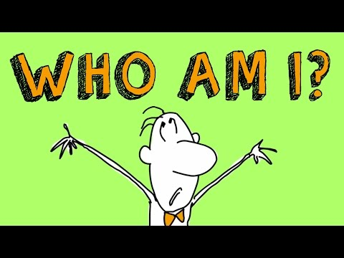
WHO AM I?
“Throughout the history of mankind, the subject of identity has sent poets to the blank page, philosophers to the agora and seekers to the oracles. These murky waters of abstract thinking are tricky to navigate, so it’s probably fitting that to demonstrate the complexity, the Greek historian Plutarch used the story of a ship. Amy Adkins illuminates Plutarch’s Ship of Theseus.”

Slide 149
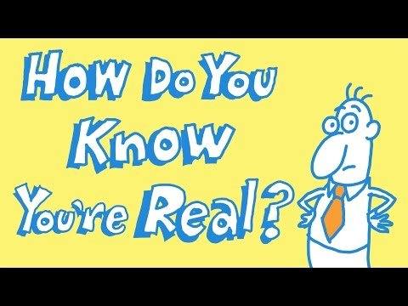
How Do You Know You Exists?
“How do you know you’re real? Is existence all just a big dream? Has some mad scientist duped us into simply believing that we exist? James Zucker investigates all of these questions (and more) in this mind-boggling tribute to René Descartes’s Meditations on First Philosophy.”
Link

Slide 150
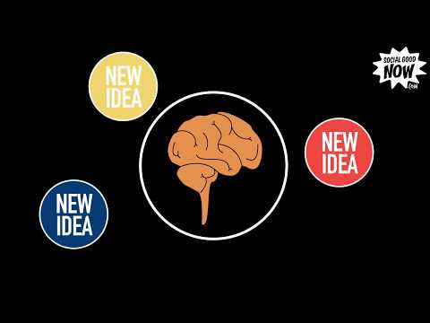
Why Facts Don't Convince People (and what you can do about it)
“Humans aren't rational creatures, but the folks at 'Social Good Now' have some ideas for what we can do about it.”
Link

Slide 151
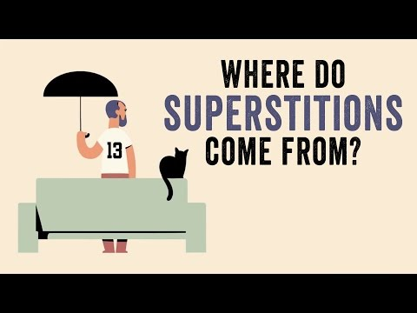
Where do superstitions come from?
“Are you afraid of black cats? Would you open an umbrella indoors? How do you feel about the number 13? Whether or not you believe in them, you’re probably familiar with a few of these superstitions. But where did they come from? Stuart Vyse shares the weird and specific origins of some of our favorite superstitions.”
Link

Slide 152
If news is fact based, why do we choose different places to get our news?
“With the advent of the Internet and social media, news is distributed at an incredible rate by an unprecedented number of different media outlets. How do we choose which news to consume?”
Link

Slide 153
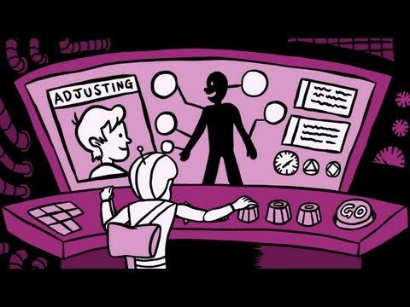
Re-Thinking Thinking
“Every day, we meet people and process our interactions--making inferences and developing beliefs about the world around us”
Link

Slide 154
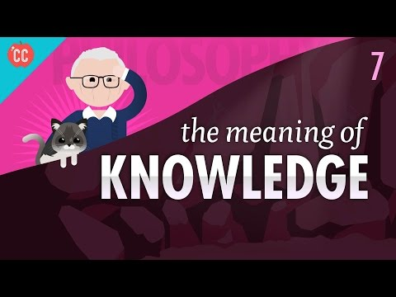
The Meaning of Knowledge
What does it mean to know something?
Link

Slide 155
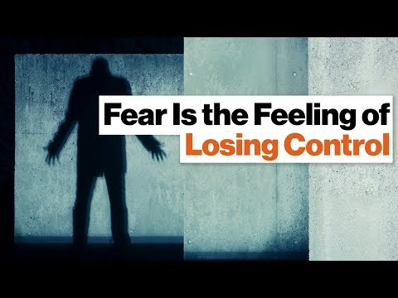
Why do we fear what we can’t control?
Airplanes,
Hospital,
Old Age...

Slide 156
Do we have free will?
Robert Sapolsky posits that "I picked this shirt today because the culture I come from has these values and my visual color receptors told me that this shirt matches with this." It might be far fetched to some, but consider this: if the street you'd grown up on was wide (say, a Texas highway) and at age 30 you moved to a tiny cobblestone street, you'd feel cramped in. Apply this to everything around you and you'll get a sense of what Sapolsky is talking about.

Slide 157
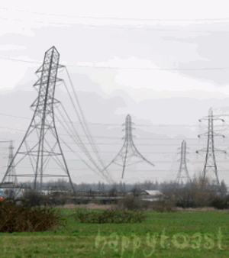
Why can some people hear this gif?
Link

Slide 158
What is the difference between information and knowledge?

Slide 159
What is the difference between knowing and believing?

Slide 160
Links
IB Learner Profile
Mr Hoye’s TOK Website
Theory of Knowledge Guide
Theory of Knowledge Teacher Support Material
Further TOK Resources found here.

