Slide 1
Arguments and Logical Fallacies
Errors in reasoning
From TOKTopics.com

Slide 2
What are the parts of an argument?
Example: I am really healthy now because I lost a lot of weight.
What is the conclusion? What are the reasons provided?
Conclusion (The what): I am really healthy now
Reasons/evidence (The why): I lost lots of weight.
Assumption: This is the missing, or the invisible part of the argument that must be true for the argument to make sense. It links the evidence and the conclusion.
What is the assumption here?
That losing weight is healthy.

Slide 3
Example #2
Identify:
  Conclusion
  Reasons/Evidence
  Assumption
Example: Barry Bonds is the greatest player in baseball history because he hit more homeruns in his career than anyone else.

Slide 4
Logical Fallacies
A fallacy is an incorrect argument based on a flaw in reasoning. Often the mistake is in the assumption that links the evidence and the conclusion.
What are the flaws in our previous two arguments.
1. I am really healthy now because I lost a lot of weight.
2. Barry Bonds is the greatest player in baseball history because he hit more homeruns in his career than anyone else.

Slide 5
What’s wrong with this?
I used to eat a lot of spicy food and then I got the worst stomach aches as a result. Turns out I had ulcers in my stomach. If you keep eating all that spicy food then you’ll get ulcers too.
First identify the conclusion and reasons and then the assumption. Once done, try to explain what is wrong with it.

Slide 6
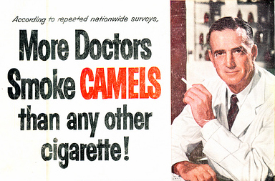

Slide 7
Appeal to authority
Appeal to majority
Authority: Using an authority as evidence in your argument when the authority is not really an authority on the facts relevant to the argument.
Majority: A claim is accepted to be true simply because most people are favorably inclined towards the claim

Slide 8
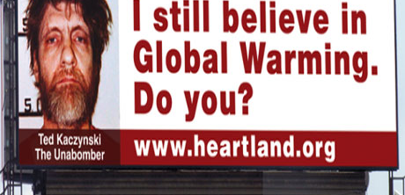

Slide 9
Poisoning the well, ad hominem attack
To prime the audience with adverse information about the opponent from the start, in an attempt to make your claim more acceptable

Slide 10
True…
I think he is unattractive because he is ugly

Slide 11
Circular argument, begging the question
The premises include the claim that the conclusion is true or assume the conclusion is true.
The premise and conclusion are one in the same

Slide 12
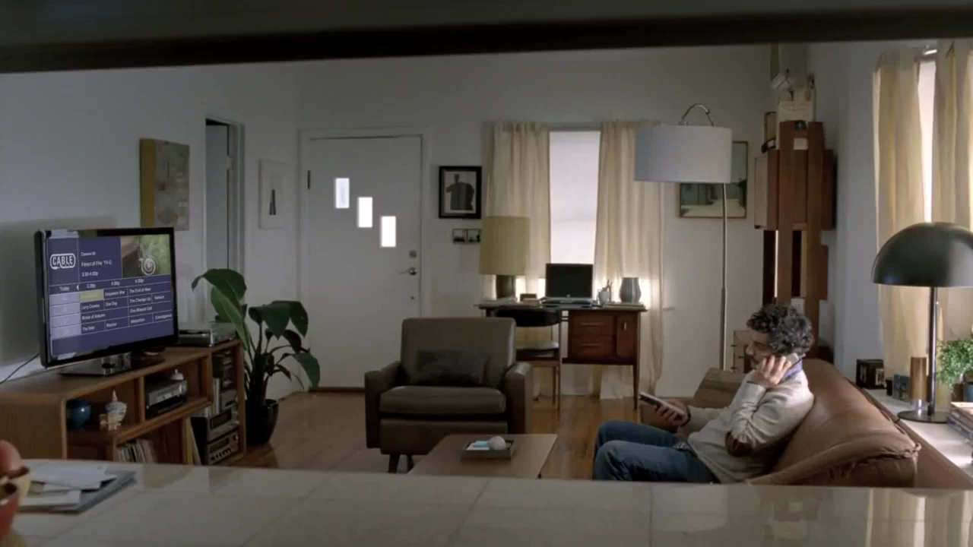
DirecTV Commercial

Slide 13
Slippery Slope Argument
A person asserts that some event must inevitably follow from another without any argument for the inevitability of the event in question. In most cases, there are a series of steps or gradations between one event and the one in question and no reason is given as to why the intervening steps or gradations will simply be bypassed

Slide 14
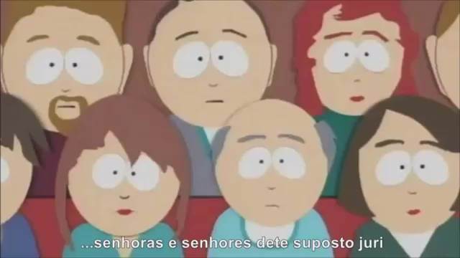
“Chewbacca Defense”

Slide 15
Non Sequitur Argument
An argument in which its conclusion does not follow from its premises

Slide 16
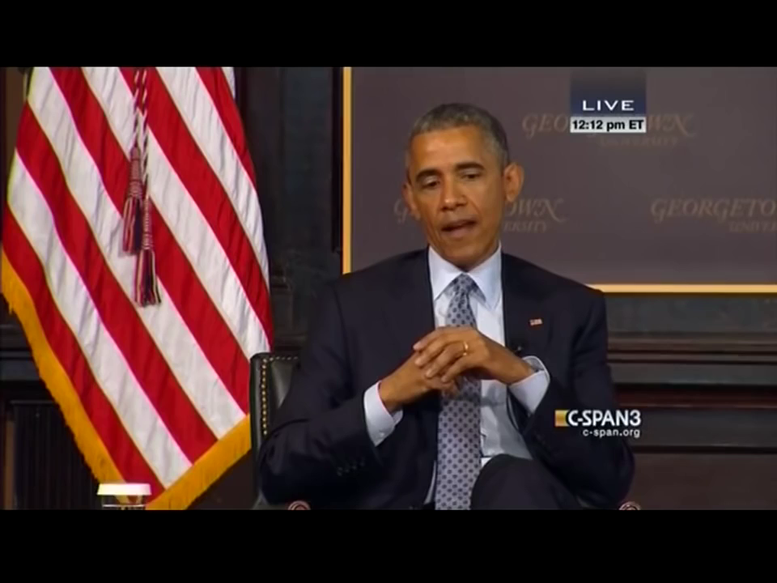
Who is he arguing with?

Slide 17
Strawman Argument
When a person simply ignores a person's actual position and substitutes a distorted, exaggerated or misrepresented version of that position

Slide 18
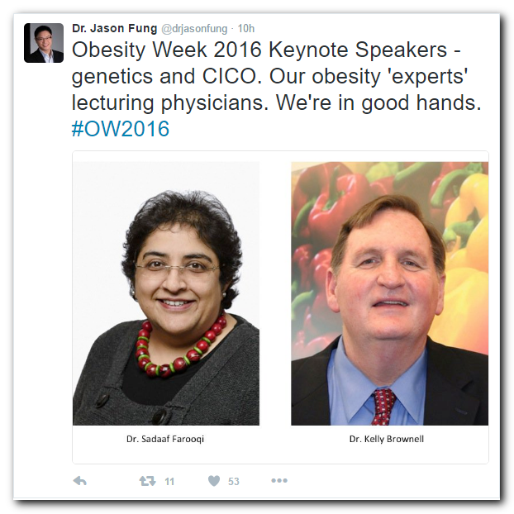
Break down the following “argument.”
What’s the conclusion/message?
What are the reasons given?
What is the assumption?
What’s wrong with this reasoning?

Slide 19
Analysis
Conclusion: You should not trust what these experts have to say on the topic of obesity.
Reason: They are fat.
Assumption: If you are guilty of something you cannot have a valid opinion on the subject.

Slide 20

“With us or against us”

Slide 21
Black or White
Two possibilities are presented as the only possibilities when in fact more possibilities exist.

Slide 22

Lyndon Johnson’s “Daisy Ad” 1964

Slide 23
Appeal to emotion
Trying to use emotional reactions to make your argument rather than reason. Trying to make someone feel sad, fearful, or guilty (or other emotion) to make them believe what you want.

Slide 24
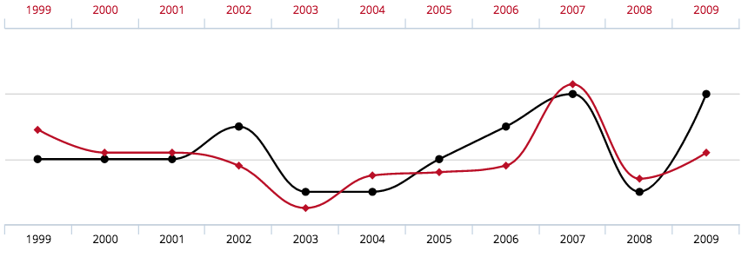
Is there a causal relationship?

Slide 25
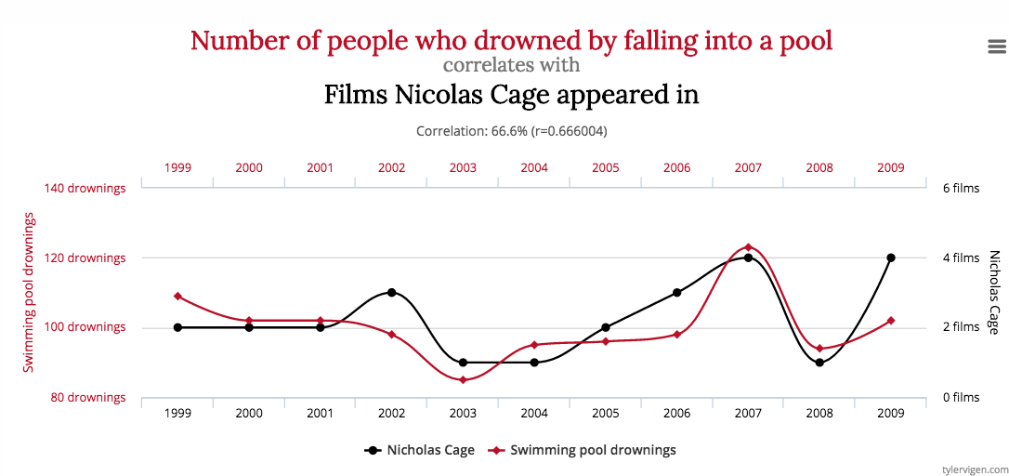
Are you sure?

Slide 26
What’s the relationship?
Adolf Hitler, Saddam Hussein, and Joseph Stalin all had mustaches and killed lots of people. If we want to make people safer, mustaches should be illegal.
Boys who act violently in school often play lots of violent video games. Video games are the cause of violence.

Slide 27
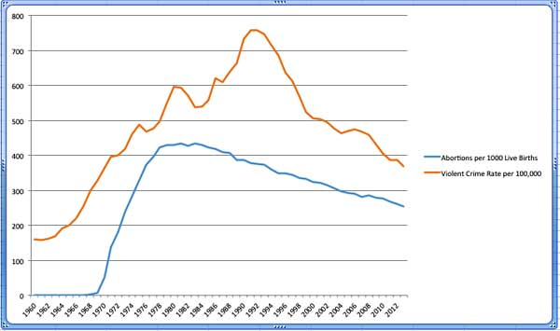
Abortions and violent crime
In a very popular book, Freakonomics, the economists identified a correlation between the abortion rate and crime. As the number of abortions increased, the crime rate went down. They assumed that there was a causal relationship. They concluded, incorrectly, that babies who were more likely to be aborted were the ones who were more likely to grow up to be criminals.

Slide 28
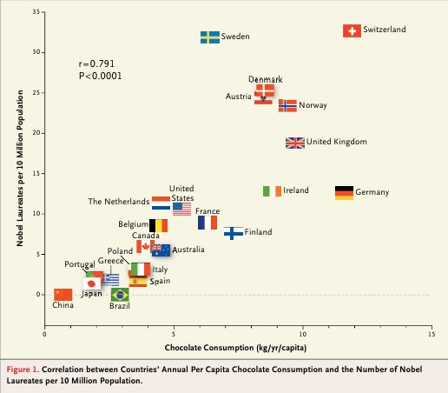
Chocolate Consumption and Nobel Prizes

Slide 29
Correlation does not equal causation, False Cause
Two things may be correlated or related but it does not mean that one thing caused the other. Sometimes the causality is reversed and sometimes there is no relationship at all. It is also possible that the two phenomenon are caused by a different third cause and sometimes it is impossible to know the nature of the relationship.

Slide 30
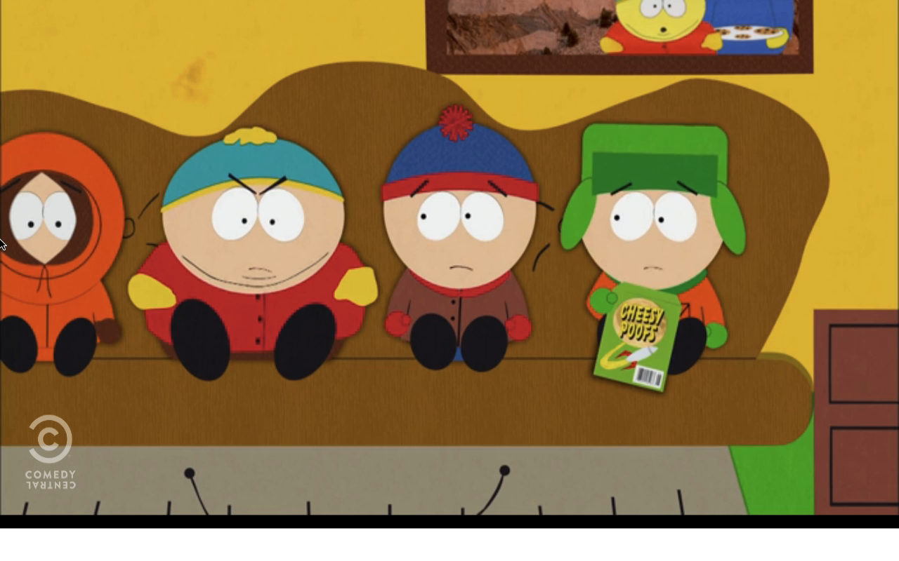
“Chewbacca Defense”
http://southpark.cc.com/clips/103454/the-chewbacca-defense

